Slide 1

WEATHER APP

Slide 2
Team members
19H51a0525 – S. Madhuri
19H51a0526 – Sufyan azar
19H51a0527 – tanisha garg

Slide 3
CONTENTS
ASTRACT
INTRODUCTION
EXISITING SOLUTIONS
PROPOSED SOLUTION
Architecture
conclusion

Slide 4
ABSTRACT
Weather is the state of the atmosphere at a given place and time in regards to heat, cloudiness, dryness, sunshine, wind, and rain. Of all the geophysical phenomena weather is the most significant one that influences us. Weather can vary greatly and largely depends on climate, seasons and various other factors. The main goal of this application is to get the weather forecast of any city throughout the world through an application.

Slide 5
INTRODUCTION
Weather forecast is the application to predict the conditions of the atmosphere for a particular location and time. In this project, we are implementing the “Weather App” in android using kotlin. We are preferring to use android studio for the development of this app. We can use any version of android studio.
It works with any city in the world. We will be able to search a specific location and toggle displaying the data in Celsius. We will change the look of the page based on the data, by changing the colour of the background or by adding images that describe the weather.

Slide 6
purpose
TO PLAN MEETINGS
To plan journeys ahead
To know when rain comes or stops
To receive alarm during cyclones, typhoons, etc
To decide what to wear

Slide 7
EXISTING solutions
1Weather
Yahoo weather
accuweather

Slide 8
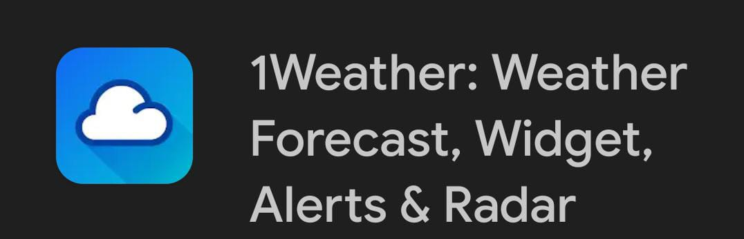
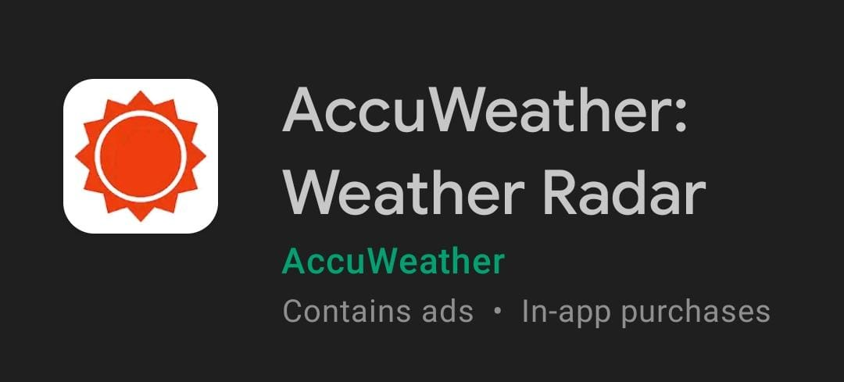
1Weather
It is a popular weather app which has features like daily and hourly forecast. But it can track only 12 cities.
Accuweather
It features extended forecasts, hourly forecast. It predicts rain on a mintute-by-minute basis. This app underwent re-design in mid 2020 and introduced a bunch of new bugs that haven’t been fixed yet.

Slide 9
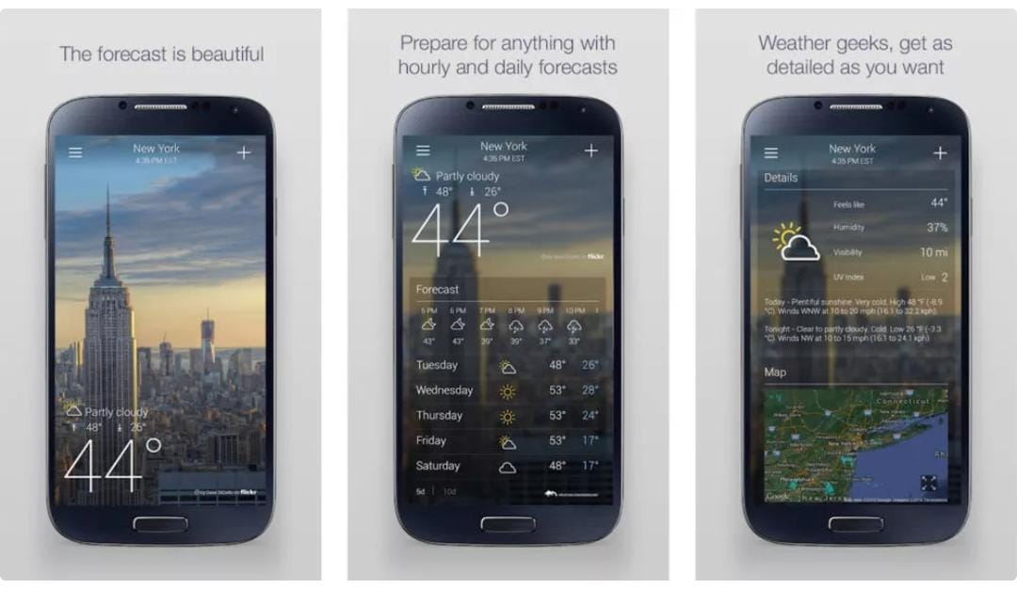
Yahoo weather app
It features a beautiful design, essential weather information, weather alerts. But this app can only track up to 20 cities.

Slide 10
Proposed solution
We can check the weather at any places through our proposed system. We are using android studio in which location service is accessed from location manager. This will extract the current location and displays the weather. Weather details is obtained from the function ‘weatherDetailListLiveData' that takes an API url of weatherapi.com.

Slide 11
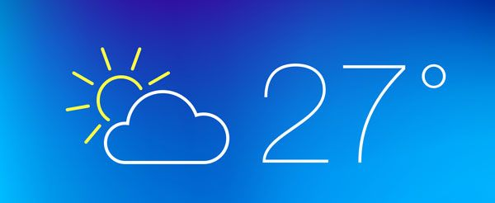
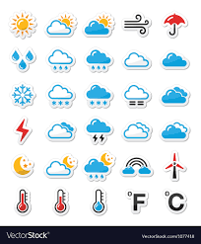
Whenever weather condition of any location is required, the city name is given as input from the search bar. This is taken from ‘FindCityWeather’ that takes the Geocoder location and acquires the temperature, time, Icon of that condition and Windspeed. Below this current weather that hourly weather forecast is displayed. It is in the sequence of hour to hour that shows time, temperature, and weather condition with icon of that forecast. We can scroll horizontally to check what weather is forecasting at what time.

Slide 12
REQUIREMENT ANALYSIS
HARDWARE REQUIRED:
Standard computer with atleast i3 processor
Standard computer with 4GB of RAM
Standard computer with 100GB of free space
Active Internet Connectivity with good bandwidth
SOFTWARE REQUIRED:
Android Studio

Slide 13

ANDROID STUDIO:
Android studio is the official Integrated Development Environment (IDE) for Google’s android operating system, designed specifically for Android development. It is available for download on Windows, macOS and Linux based operating systems. It is a replacement for the Eclipse Android Development Tools as the primary IDE for native Android application development. It has a rich layout editor that allows users to drag-and-drop UI components, option to preview layouts on multiple screen configurations. It has Android Virtual Device(Emulator) to run and debug apps. Supports Java, C++, Kotlin, etc., programming languages.

Slide 14
Weather App
Current Location
Other Location
By default current location is tracked
Input city name in search bar
Current Time weather displayed
Hourly Weather is displayed down

Slide 15
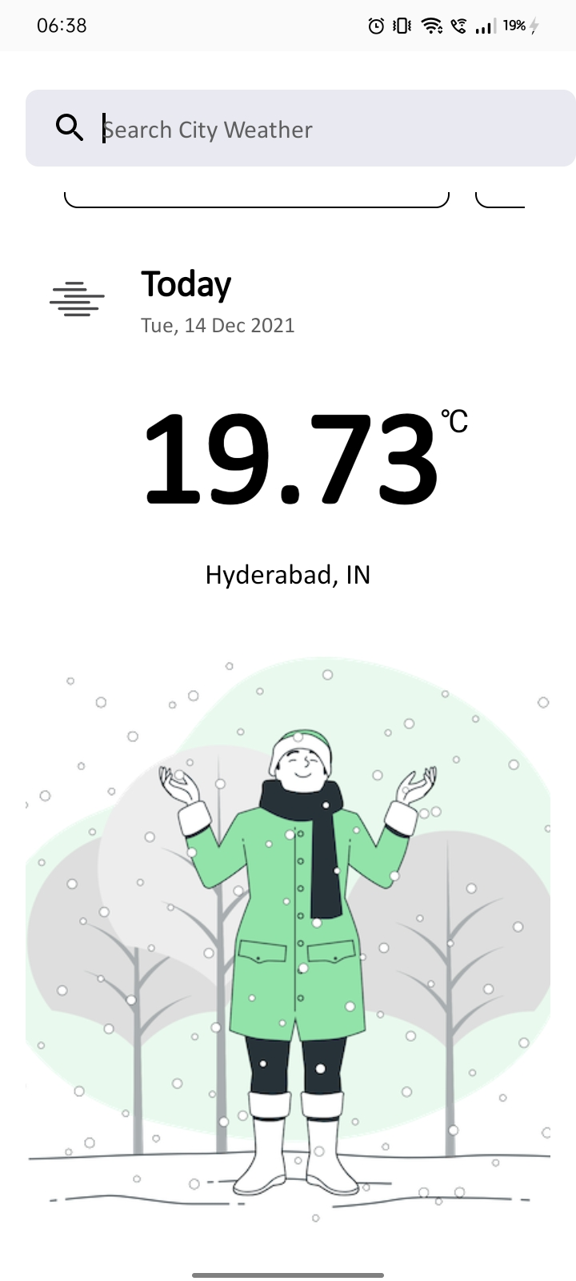
RESULt
This is the output display of the application. Search for any City in the world and get the Weather condition of that area.

Slide 16
REFERENCES
https://www.tomsguide.com/round-up/best-weather-apps
https://www.androidauthority.com/best-weather-apps-and-weather-widgets-for-android-256942/
https://www.spaceo.ca/best-weather-apps/

Slide 17
THANK YOU

